Slide 1
Lecture 3 Chapter-02 Discrete-Event System Simulation -Jerry Banks
Simulation of Queuing System
Single channel Queue
‹#›

Slide 2
Simulation Examples
Three steps of the simulations
Determine the characteristics of each of the inputs to the simulation. Quite often, these may be modeled as probability distributions, either continuous or discrete.
Construct a simulation table. Each simulation table is different, for each is developed for the problem at hand.
For each repetition i, generate a value for each of the p inputs, and evaluate the function, calculating a value of the response y_{i}. The input values may be computed by sampling values from the distributions determined in step 1. A response typically depends on the inputs and one or more previous responses.
‹#›

Slide 3
Simulation Table
The simulation table provides a systematic method for tracking system state over time.
Inputs
Response
Repetitions
X_{i1}
X_{i2}
…
X_{ij}
…
X_{ip}
y_{i}
1
2
·
·
·
n
‹#›

Slide 4
Simulation of Queuing Systems (1)
Server
Waiting Line
Calling population
Fig. 2.1 Queueing System
A queueing system is described by its calling population, the nature of the arrivals, the service mechanism, the system capacity, and the queueing discipline.
‹#›

Slide 5
Simulation of Queuing Systems (2)
In the single-channel queue, the calling population is infinite.
If a unit leaves the calling population and joins the waiting line or enters service, there is no change in the arrival rate of other units that may need service.
Arrivals for service occur one at a time in a random fashion.
Once they join the waiting line, they are eventually served.
Service times are of some random length according to a probability distribution which does not change over time.
The system capacity has no limit, meaning that any number of units can wait in line.
Finally, units are served in the order of their arrival (often called FIFO: First In, First out) by a single server or channel.
‹#›

Slide 6
Simulation of Queuing Systems (3)
System state : the number of units in the system and the status of the server(busy or idle).
Event : a set of circumstances that cause an instantaneous change in the state of the system.
In a single-channel queuing system there are only two possible events that can affect the state of the system.
the arrival event : the entry of a unit into the system
the departure event : the completion of service on a unit.
Simulation clock : used to track simulated time.
‹#›

Slide 7
Simulation of Queuing Systems (4)
If a unit has just completed service, the simulation proceeds in the manner shown in the flow diagram of Figure 2.2.
Note that the server has only two possible states : it is either busy or idle.
Departure Event
Begin server idle time
No
Another unit waiting?
Yes
Remove the waiting unit from the queue
Begin servicing the unit
Fig. 2.2 Service-just-completed flow diagram
‹#›

Slide 8
Simulation of Queuing Systems (5)
The arrival event occurs when a unit enters the system.
The unit may find the server either idle or busy.
Idle : the unit begins service immediately
Busy : the unit enters the queue for the server.
Arrival Event
Unit enters service
No
Server busy?
Yes
Unit enters queue for service
Fig. 2.3 Unit-entering-system flow diagram
‹#›

Slide 9
Simulation of Queuing Systems (6)
Simulations of queuing systems generally require the maintenance of an event list for determining what happens next.
Simulation clock times for arrivals and departures are computed in a simulation table customized for each problem.
In simulation, events usually occur at random times, the randomness imitating uncertainty in real life.
Random numbers are distributed uniformly and independently on the interval (0, 1).
Random digits are uniformly distributed on the set {0, 1, 2, … , 9}.
‹#›

Slide 10
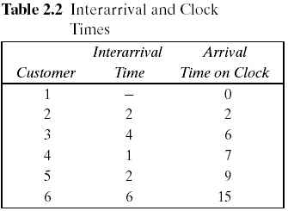
Simulation of Queuing Systems (7)
Pseudo-random numbers : the numbers are generated using a procedure.
Table 2.2. Interarrival and Clock Times
Assume that the times between arrivals were generated by rolling a die five times and recording the up face.
‹#›

Slide 11
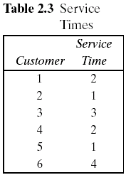
Simulation of Queuing Systems (8)
Table 2.3. Service Times
Assuming that all four values are equally likely to occur, these values could have been generated by placing the numbers one through four on chips and drawing the chips from a hat with replacement, being sure to record the numbers selected.
The only possible service times are one, two, three, and four time units.
‹#›

Slide 12
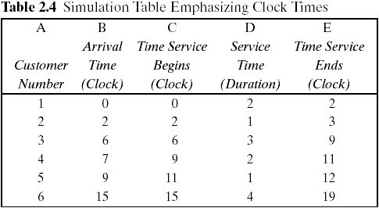
Simulation of Queuing Systems (9)
The interarrival times and service times must be meshed to simulate the single-channel queuing system.
Table 2.4 was designed specifically for a single-channel queue which serves customers on a first-in, first-out (FIFO) basis.
‹#›

Slide 13
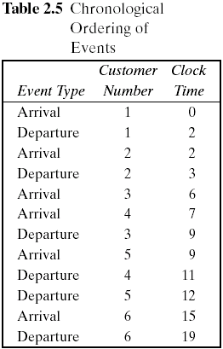
Simulation of Queuing Systems (10)
Table 2.4 keeps track of the clock time at which each event occurs.
The occurrence of the two types of events(arrival and departure event) in chronological order is shown in Table 2.5 and Figure 2.6.
Figure 2.6 is a visual image of the event listing of Table 2.5.
The chronological ordering of events is the basis of the approach to discrete-event simulation.
‹#›

Slide 14
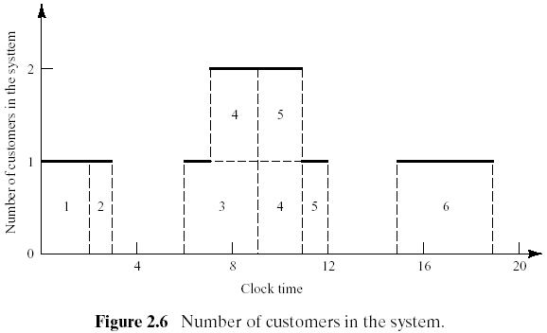
Simulation of Queuing Systems (11)
Figure 2.6 depicts the number of customers in the system at the various clock times.
‹#›

Slide 15
Thank you
‹#›

